Slide 1

Identifiers: Variables & Constants
Identifiers
● Must start with a letter, an underscore, or a dollar sign
● Cannot contain operators
● Cannot be reserved word
● Cannot be true, false or null
● Can be of any length.
$2 Area Char a

Slide 2
Variables
● Used to store data
● must have a name, a type and a value
● Three kind of variables : instance, class and local.
Declaring variables
Syntax
type identifier [ = value] [, identifier [= value]…];
Example
int x;
double radius;

Slide 3
Declaring and Initializing in one step
● Whenever possible, declare a variable and assign its initial value in one step. This makes the program easy to read.
Example
int x = 1;
double radius = 45.5 ;

Slide 4
class student
{ String name,ICNO;
int mark;
static String classcode
void check_status()
{String status =null;
………
……...
}
}
Instance variables
Class
variable
Local
variable

Slide 5
Constant
● represent permanent data that never changes during execution.
● use keyword final
Declaring a constant
Syntax
static final datatype CONSTANTNAME = VALUE
Example
final float PI = 3.14159;

Slide 6
How to write a program to compute the are of a circle
Writing a program involves designing algorithms and data structures.
The algorithm
1. Read in the radius
2. Compute the area using formula :
area = radius * radius * π
3. Display the area

Slide 7
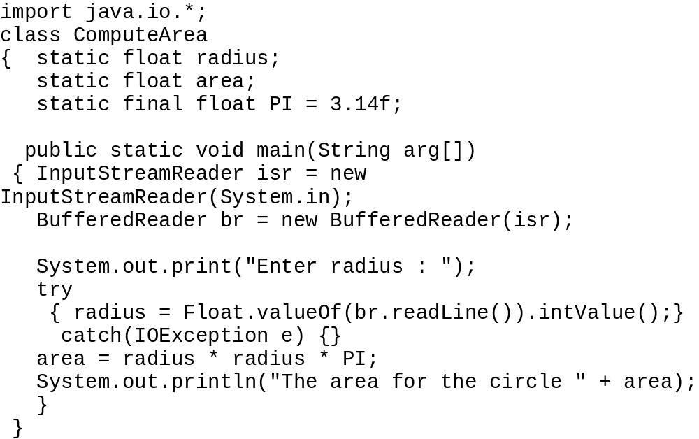
JAVA program
variable
Constant

Slide 8
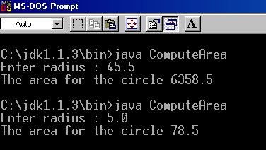
The program use variables to represent the radius and the area, use a constant π, and use an expression to compute the area.
Compile and run the program and get the output …….

Slide 9
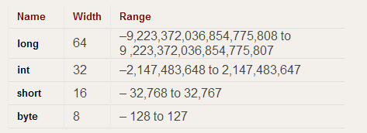
Data Types & Operators
Data Types
Integer
Floating point
Character
Boolean
byte
float
char
boolean
short
int
long
double

Slide 10
Operators
Arithmetic
Relational
Logical
Increment/ Decrement
! && ||
+ - / * %
++ --
> >= < <= == !=

Slide 11
FLOWCHARTS
Input/Output
sequential statement
logical operator
flowline
Notes:
Deitel70
A flowchart is a graphical representation of an algorithm. Flowcharts are drawn using certain special-purpose symbols such as rectangles, diamonds, ovals. These symbols are connected by arrows called flowlines that indicate the order in which the actions of the algorithm execute. Flowcharts show clearly how control statements operate.
The rectangle symbol is also called the action symbol, to indicate any type of action including a calculation or an input/output operation. The diamond symbol is called the decision symbol.

Slide 12
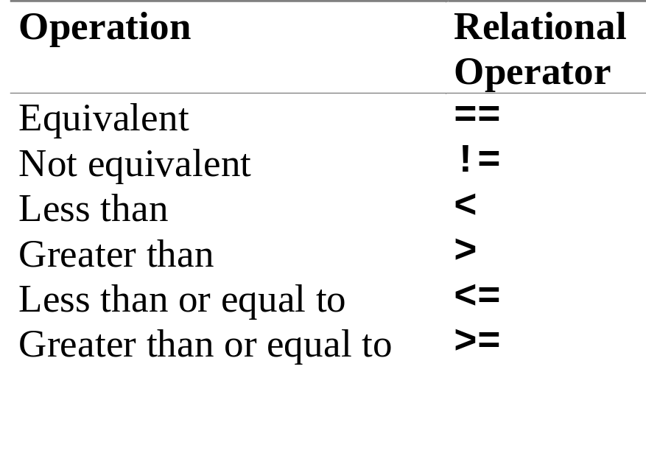
RELATIONAL OPERATORS
Notes:
Precedence
Additivity
Deitel 39-40
Java applies the operators in arithmetic expressions in a precise sequence determined by the following rules of operator precedence, which are generally the same as those followed in algebra:
Operators in expressions contained within pairs of parentheses are evaluated first. Thus, the parentheses may be used to force the order of evaluation to occur in any sequence desired by the programmer. Parentheses are said to be at the “highest level of precedence”. In cases of nested or embedded parentheses, the operators in the innermost pair of parentheses are applied first.
Multiplication, division and modulus operations are applied next. If an expression contains several multiplication, division or modulus operations, operators are applied from left to right. These operation are said to be on the same level of precedence.
Addition and subtraction operation are applied last. They also have the same level of precedence and are applied from left to right.

Slide 13
RELATIONAL OPERATORS - EXAMPLES
int i1 = 15; // first operand
int i2 = 6; // second operand
boolean result; // the result
result = i1 == i2;
result = i1 != i2;
result = i1 < i2;
result = i1 <= i2;
result = i1 > i2;
result = i1 >= i2;

Slide 14
Control Structures
Control Structures
Selection/ Making decisions
Looping
if
for
switch
while
do..while

Slide 15
If statement
Simple if statement
format :
if (boolean Expression)
{ statement (s); }
Boolean
expression
false
true
Statement (s)
Next statement

Slide 16
Multiple statements in an If statement
Example :
if ( radius > =0)
{
area = radius * radius * PI;
System.out.println(“The area of the
circle is “ + area);
}
Radius > =0
false
true
area = radius * radis * PI
Display area
Next statement

Slide 17
if .. else statement
format :
if (booleanExpression)
{ statement(s1) for the true case; }
else
{ statement(s2) for the false case;}
false
true
Boolean
expression
Statement (s2)
Statement ( s1)
Statement s1 is executed
if boolean expression value
is true
Statement s2 is executed if boolean expression value
is false
Next
Statement

Slide 18
Example :
if ( radius > =0)
{
area = radius * radius * PI;
System.out.println(“The area of the
circle is “ + area);
}
else
{
System.out.println (”Negative input”);
}
Radius > =0
false
true
area = radius * radis * PI
Display “Negatif
input”
Display area
Next statement

Slide 19
Nested if Statements
● Nested if is an if statement that is the target of another if or else.
● When the if statement are nested, an else statement always refers to the nearest if statement that is within the same block as the else and that is not already associated with an else.
Example:
Suppose you want to pay a RM50 bonus to a salesperson
only if the salesperson sells more than three items that
total more than RM1000 in value during a specified time.

Slide 20
Nested if..else
Syntax
if (booleanExpression)
{ statement(s1);}
else if (booleanExpression)
{ statement (s2); }
else if ( booleanExpression)
{ statement(s3); }
…
...
else statement (n); }
The if statements are executed from the top down.

Slide 21
Example of nested If
If the salesperson does not sell more than three items, you
want to give a RM10 bonus; if the salesperson sells at least
three items, the bonus is RM25 if the value of the items is RM1000
or less, or RM50 if the value is more than RM1000.
Draw the flowchart to express the statements.

Slide 22
Using Logical AND and OR Operators
&& → AND
|| → OR
With the && operator, both Boolean expressions that surrounds the
Operator must be true.
With the || operator, at least one of two conditions is true.

Slide 23
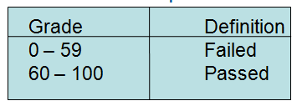
EXERCISE
CSC 2310 (JAVA)

Slide 24
SWITCH STATEMENT
By nesting a series of if and else statements, you can choose from
any number of alternatives. Example:
if (year ==1)
System.out.println (“Freshman”);
else If(year == 2)
System.out.println (“Junior”);
else if (year ==3)
System.out.println (“Senior”);
else
System.out.println (“Invalid year”);
The switch statement is useful when you need to test a single variable
againts a series of exact integer or character values.

Slide 25
switch
Syntax
switch (Expression)
{ case value 1 : statement s1; break;
case value2 : statement s2; break;
case value3 : statement s3; break;
…
…
case valueN : statement N; break;
default : default statement; }
● The case statements are executed from the top down.

Slide 26
int year;
switch (year)
{
case 1: System.out.println (“Freshman”);
break;
case 2: System.out.println (“Junior”);
break;
case 3: System.out.println (“Senior”);
break;
default: System.out.println (“Invalid year”);
}

Slide 27
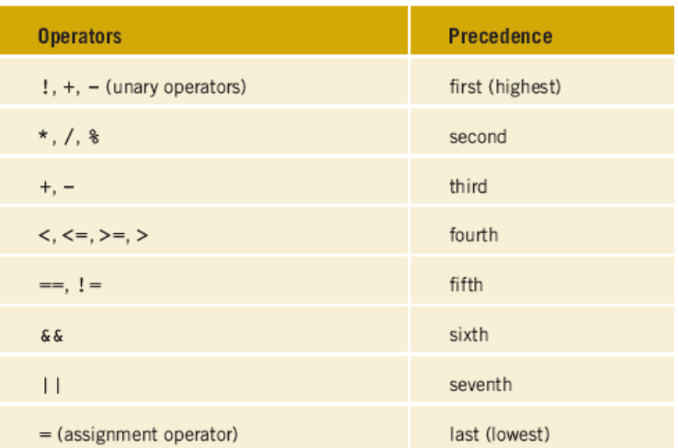
Understanding Precedence

Slide 28
Testing the operator precedence
Based from the precedence in the previous slide, check
which statement is true or false
30 year old female driver with three traffic tickets.
if( trafficTickets > 2 || age < 25 && gender == ‘M’)
extraPremium = 200;
If (trafficTickets > 2 || age < 25) && gender == ‘M’)
extraPremium = 240;
total = total + extraPremium;

Slide 29
for Loop
● Always used when the number of times to repeat an operation is already known.
Syntax
for (control variables; condition; adjustment statement)

Slide 30
…continue
● The flowchart of the for loop is like below
i =0
Initializes the control variables, i
i++
i < 10?
false
Adjust the control
variables and is
executed after
iteration.
If true execute the loop
body, otherwise the loop
terminates and the
program control turns
to the lilne following the
loop.
true
Display
“MSU”
Next
statement

Slide 31
Tracing Table:
for (b= 1; b<3; ++b){
System.out.println (b + “ “);}
1 1 1
1 2 3
1 2 3 4
nothing}

Slide 32
Tracing Table:
for (m=0;m<=2; ++m)
{
for (n=0;n<2;++n)
{
System.out.println (m + “ “ + n + “ “);
}}
0 0 0 1 1 0 1 1 2 0 2 1
0 1 0 2 1 1 1 2 2 1 2 2
4 2
3 1

Slide 33
while loop
● Always used when the number of times to repeat an operation is unknown.
Syntax
while (continue-condition)
{
// loop-body
}

Slide 34
…continue
● The while loop flow chart is like below:
● The while loop repeatedly executes the statements in the loop body when continue-condition evaluates as true.
Continue
condition
false
true
Statement(s)
Next
statement

Slide 35
do .. while
● A variation of the while loop
Syntax
do
{
// loop body;
}while ( continue-condition);

Slide 36
…continue
● The do.. while loop flow chart is like below:
● The loop body is executed first. Then the continue-condition is evaluated. If the evaluation is true, the loop body is executed again; otherwise the do loop terminates.
Statement(s)
true
Continue
condition
false
Next
statement

Slide 37
Break and continue
Break
a) Use in a switch statement
b) Using break to exit a loop
● Can force immediate termination of a loop
● When a break statement is encountered inside a
loop, the loop is terminated and program control
resumes the next statement following the loop.
continue
● Useful to force an early iteration of a loop
● Continue running the loop, but stop processing the
remainder of the code in the loop body.

Slide 38
Exercise 1
Write an application for a college’s admission office. Prompt the
User for a student’s numeric high school grade point average and
An admission test score from 0 to 100. print the message “accept”
If the student has any one of the following:
>> a grade point average of 3.0 or above and an admission test score
Of at least 60
>> a grade point average below 3.0 and an admission test score of at
Least 80
If the student does not meet either of the qualification criteria, print
“reject”. Save the file as Admission.java.

Slide 39
Exercise 2
Modify the application in first exercise so that if a student enters
A grade point average under 0 or over 4, or a test score under 0 or
Over 100, an error message appears instead of the “Accept” or
“Reject” message. Save the file as Admission2.java.

Slide 40
Exercise 3
Write a program for a lawn mowing service. The lawn mowing
season lasts twenty weeks. The weekly fee for mowing a lot under
400 square feet is RM25. The fee for a lot 400 square feet or
more but under 600 square feet is RM35 per week. The feet for a lot
600 square feet or over is RM50 per week. Input the length and width
from the keyboard for twenty weeks, calculate the area of the lawn,
determine and display the total of twenty weeks mowing fee

Slide 41
Exercise 3
To the lawn application you created in previous exercise, add a
Prompt that asks the user whether the customer wants to pay
once, (2) twice, or (3) 20 times per year. If the user enters 1
For once, the fee for the season is simply the seasonal total. If the
Customers requests two payments, each payment is half the seasonal
Fee plus a RM5 service charge. If the user requests 20 separate
Payments, add a RM3 service charge per week.
Display the number of payments the customer must make, each
Payment amount , and the total for the season. Save the file as
Lawn.java.

Slide 42
Exercise 4
Trace the program and determine the output
a) double a = 20;
double sum = 0;
while (a < 30)
{
sum += a;
}
System.out.println(sum)
b) double a = 2;
double b = 5;
int sum = 0;
do
{
sum += a + (++b)
}while (b < 20);
System.out.println(sum)

Slide 43
Exercise 5
Write an application that asks a user to type 1, 2,3 or 4.
When the user types 4, the program ends. When the
user type 1,2 or 3, the program displays the message
“Good Job!” and then asks for another input. When the
user types any other number, the application issues
an error message and then asks for another input. Save
the file as Input123.java.

Slide 44
Exercise 6
write a application that display a series of at least two survey
question; the survey can be on any social or political topic, each
question should have at least two possible numeric choice answers.
at the end the survey, use a dialog box to ask whether the user wants to
1.enter another set of responses to the same set of questions
2. quit
continue to accept the sets of responses until the user chooses to quit,
and then display the results of the survey for each question indicate
how many users chose the first option, second option, and so on.

Slide 45
Exercise 7
Problem
1. Write a program that reads and calculate the sum of an unspecified
Number of integers. The input 0 signifies the end of the input.
Use scanner as your input medium.
2. Write a program that sums a series that starts with 0.01 and ends with
1.0. the numbers in the series will increment by 0.01, as follows:
0.01 + 0.02 + 0.03 …..

Slide 46
Exercise 8
Write an application that prints all even numbers from 2 to 100 inclusive.

Slide 47
// Using break to exit a loop.
class BreakLoop {
public static void main(String args[]) {
for(int i=0; i<100; i++) {
if(i == 10) break; // terminate loop if i is 10
System.out.println("i: " + i);
}
System.out.println("Loop complete.");
}
}
i: 0
i: 1
i: 2
i: 3
i: 4
i: 5
i: 6
i: 7
i: 8
i: 9
Loop complete.

Slide 48
// Using break with nested loops.
class BreakLoop3 {
public static void main(String args[]) {
for(int i=0; i<3; i++) {
System.out.print("Pass " + i + ": ");
for(int j=0; j<100; j++) {
if(j == 10) break; // terminate loop if j is 10
System.out.print(j + " ");
}
System.out.println();
}
System.out.println("Loops complete.");
}
}
Pass 0: 0 1 2 3 4 5 6 7 8 9
Pass 1: 0 1 2 3 4 5 6 7 8 9
Pass 2: 0 1 2 3 4 5 6 7 8 9
Loops complete.

